Slide 1


Disk-based key-value stores & Consistency model (linearzability)
SE3331-1 (2024 Fall)
IPADS, Shanghai Jiao Tong University
https://www.sjtu.edu.cn

Slide 2



Review: key-value store
Storage abstraction:
Each data (Value) is opaque to the underlying storage/database
The K and V can be arbitrary byte-sequence (e.g., JSON, int, string)
Indexed by a key (K), which itself is also a data
Stored on disk (tolerate failure & support a large capacity), but can also be in-memory
Application-level Interface (API)
Get(K) -> V, Scan(K,N)
Update(K,V), Insert(K,V), Delete(K,V)
Notes:
实现这个 + 子集

Slide 3
Review: Building Key-value Storage on File System
Why builds upon the file system?
We still need a system to interact with the disk hardware!
Though modern KVS may also bypass the file system, but is uncommon
“All problems in computer science can be solved by another level of indirection” -- often attributed to Butler Lampson, who attributes it to David Wheeler
Key-value Store
Key-value files
File system
Notes:
<Hints and Principles for Computer System Design>
David Wheeler： 剑桥大学

Slide 4
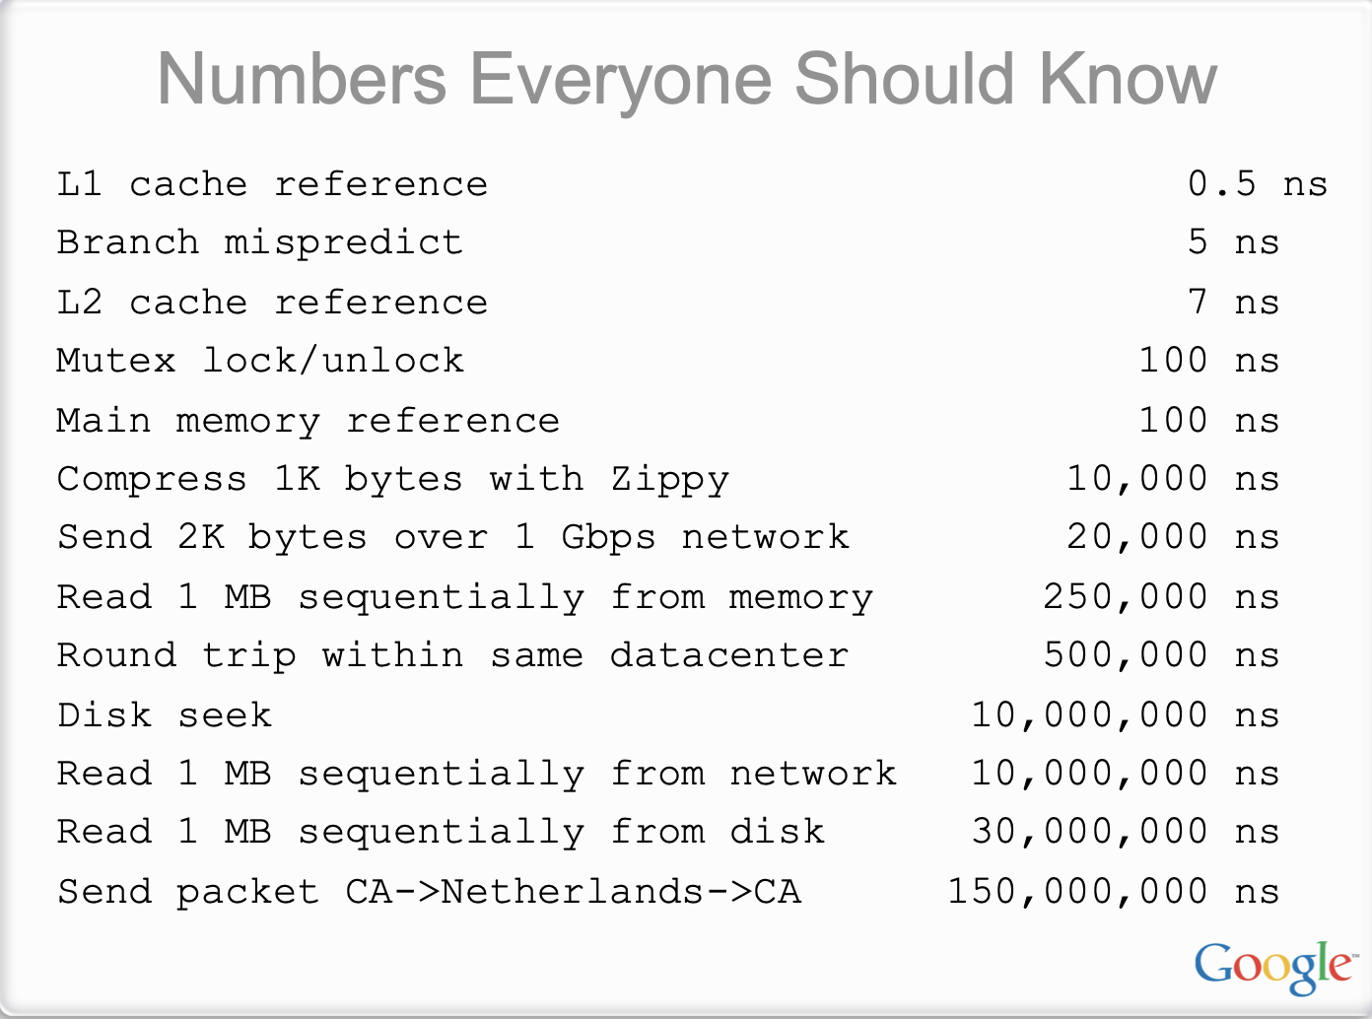
Source: Jeaf dean
Notes:
http://static.googleusercontent.com/media/research.google.com/en/us/people/jeff/stanford-295-talk.pdf

Slide 5
Review: Key system requirements of KVS
Hash Index (in-memory & on disk)
Operation efficiency
Must use sequential access for Update()/Insert() as much as possible
Must reduce random reads for Get()
Space efficiency
Minimize wasted storage
Support range query
Log file

Slide 6
Key-value store so far
Method | Update/Insert efficient | Get efficient | Range Query | Support large dataset
Log | Yes | No | No | Yes
Log + in-memory hash index | Yes | No | No | No
Log + on-disk hash | No | Medium | No | Yes

Slide 7

B-Tree (B+Tree) indexes: a form of ordered index
Introduced in 1970, the “ubiquitous” index 10 years later for disk data
Standard data structures of many databases and key-value stores
“It could be said that the world’s information is at our fingertips because of B-trees”
Goetz Graefe Microsoft, HP Fellow, now Google
ACM Software System Award
Notes:
Fingertips: 唾手可得
Goetz Graefe ： SQL server

Slide 8
Tree-based index (Mostly B-tree and its variants)
A B-tree is a tree-like data structure (one or a few files)
Each node is fixed-sized, can store multiple keys, and keys are sorted
Support efficient range operations (e.g., Scan)
Optimized for large read/write blocks of data (i.e., each node is large)
Many variants exist, e.g., B+Tree
All the leaf nodes of the B-tree must be at the same level
Simper to link leaf nodes to support range queries
Reduce height: more keys in the non-leaf nodes

Slide 9
B+Tree indexes example (fanout = 5)
13
2
3
8
13
27
Notes:
Fanout：指的是child节点的个数

Slide 10
B+Tree indexes example: Get(2)
13
2
3
8
13
27

Slide 11
B+Tree indexes example: Get(2)
13
2
3
8
13
27

Slide 12
B+Tree indexes example: Update(2)
Similar to Get()
1. find the position
2. update the value
13
2
3
8
13
27

Slide 13
B+Tree indexes example: insert(10)
13
2
3
8
13
27

Slide 14
B+Tree indexes example: insert(10)
13
2
3
8
10
13
27

Slide 15
B+Tree indexes example: insert(11)
13
2
3
8
10
11
13
27

Slide 16
B+Tree indexes example: insert(11)
10
13
2
3
8
10
11
13
27
Split the nodes!

Slide 17
B+Tree can support efficient range operations
Add a sibling link between the leaves
e.g., SCAN(3,5)
10
13
2
3
8
10
11
13
27

Slide 18
Question: need a B+Tree to index the values in the log?
No. It can store the values in its leave node
Which does not need compaction & merge (since there is no duplication)
10
13
2
3
8
10
11
13
27

Slide 19
B-Tree indexes summary
Can support range query
Get(K), Insert(K,V) and Update(K,V) are relative slow
O(log(n)) random disk accesses
Typically, is small, since B-Tree indexes (and variants like B+Tree) uses large node size. But is still a killer for performance
B+Tree indexes are not good enough for insertion-intensive workloads
Still many random disk I/O involved
Insertions are common for on-disk storages, because reads are served by other system components, e.g., a cache system like Memached
E.g., check lecture 02, step#2 for scaling a website
B+Tree index size can be large
For small values, the index size can be close to the value sizes (in the same order)
Notes:
// 分析B+Tree 索引的好坏
当然，如果insertion都是在最后，那么b树的性能也是很好的。

Slide 20
B+Tree & Hash index is not perfect
Method | Update/Insert efficient | Get efficient | Range Query | Support large dataset
Log | Yes | No | No | Yes
Log + in-memory hash index | Yes | No | No | No
Log + on-disk hash | No | Medium | No | Yes
B+Tree | No | Medium | Yes | Yes

Slide 21
Can we avoid random access for
index updates and insertions, with small index size, while supporting scans (no brute force) ?

Slide 22
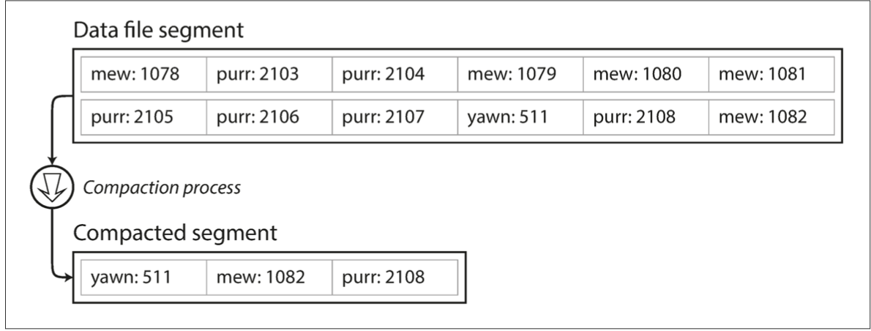
Recall: segmented log file
Compaction & segmentation
Break a file into fixed-sized segments
If a segment is full, then create a new file for insertions
Can control the compaction granularity with the segment size

Slide 23
LSM Trees: SSTables (Sorted String Table)
SSTable is based on the segmented log file described in the hash index
Break a file into fixed-sized segments
If a segment is full, then create a new file for insertion
Notes:
// 分析B+Tree 索引的好坏

Slide 24
LSM Trees: SSTables (Sorted String Table)
SSTable is based on the segmented log file described in the hash index
Break a file into fixed-sized segments
If a segment is full, then create a new file for insertion
With one extension
Key-values in a segment are sorted by the key
Side effect: old segment files are immutable
Why immutable? Inserting in a SSTable is not append-only
We will come back to this topic later
Notes:
// 分析B+Tree 索引的好坏

Slide 25
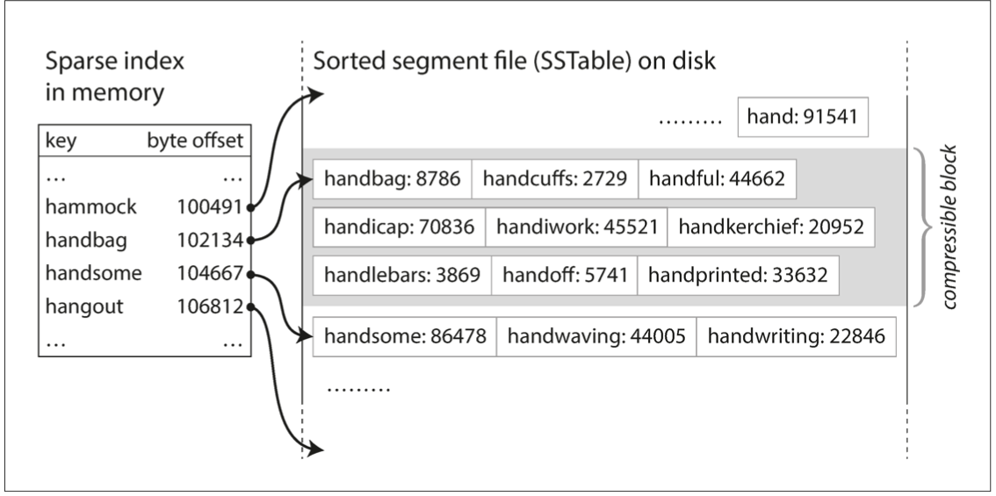
Benefits of SSTable (compared to original log file)
#1. Searching a given key in a SSTable is efficient (no brute force)
We can use binary search to lookup a given key
Or we only need some sparse index for the acceleration, one for each SSTable
E.g., one key in index for every few KB of SSTable is sufficient, since scanning them is quick

Slide 26
Benefits of SSTable (compared to original log file)
#2. Support range operations
Since the KVS are sorted in the file

Slide 27
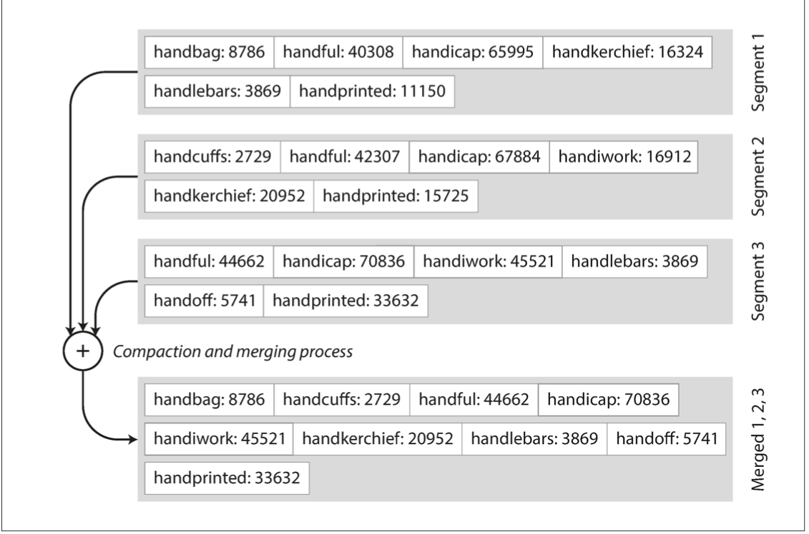
Benefits of SSTable (compared to original log file)
#3. Merging two SSTables is efficient
Even if the two tables are much larger than the available memory
Similar to the mergesort

Slide 28
How to maintain SSTable with sequential writes?
Use a MemTable: an in-memory data structure (e.g., a red-black Tree)
Simple quiz: why not using hash table?
MemTable

Slide 29
How to maintain SSTable with sequential writes?
Use a MemTable: an in-memory data structure (e.g., a red-black Tree)
Example: insert a (K, V) into SSTable
1
Insert the (K,V) into the MemTable
(K,V)
MemTable

Slide 30
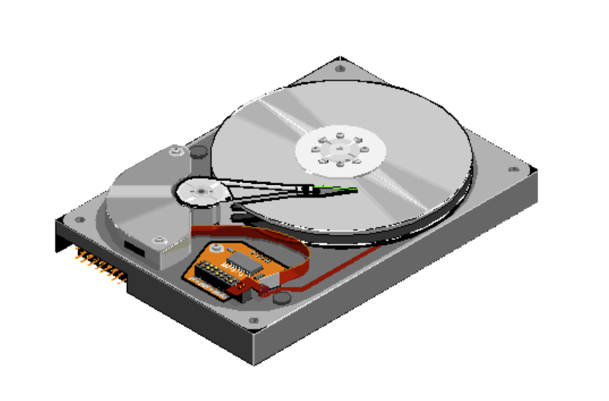
How to maintain SSTable with sequential writes?
Use a MemTable: an in-memory data structure (e.g., a red-black Tree)
Example: insert a (K, V) into SSTable
1
Insert the (K,V) into the MemTable
(K,V)
MemTable
SSTable
2
check whether MemTable exceeds some threshold,
If so, flush it to a new SSTable

Slide 31
How to maintain SSTable with sequential writes?
Use a MemTable: an in-memory sorted data structure (e.g., red-black Tree)
Example: insert a (K, V) into SSTable
3
What if there are too many SSTables?
We can merge & compact them as we have done before with segmented log files
SSTables
Merge & compact

Slide 32
Reads with MemTable + SSTable
Checks the MemTable
If misses, checks the latest SSTable
If still misses, checks the next older SSTable
…
Optimization: keep a sparse index on each SSTable to accelerate the lookup
1
2
3
4
…
MemTable
SSTables

Slide 33
Question: what are the drawbacks of
such a design?

Slide 34
Organizing data sequentially has several drawbacks
#1. Finding the old value is slow
#2. Deduplication is hard
#3. Range query is still inefficient
New
Old
1
2
3
4
…
MemTable
SSTables

Slide 35
LSM Tree organizes SSTables in a hierarchy
The famous Log-structured merge tree
Each layer has the entire KVS data of some time
Each layer has maximum size
Except L0, all files in layers are sorted, and does not have duplicated keys
Except L0, keys in each layer is sorted according to the SSTable
New
MemTable
L0
L1
L2
LSM Tree
Old
Notes:
The keys in a layer is sorted

Slide 36
Hierarchy can speed up old value lookup
Each layer has only one file that store the key (except L0)
So we can search only one file per-layer (not per-file search)
Question: how to find the key file?
Accelerated with spares index
Also store a [min, max] per file
Search layer-by-layer
Read upon lower layers
First identify the file, then look it!
O(1) access per layer
MemTable
New
L0
L1
L2
LSM Tree
Old
Notes:
Each layer has only one

Slide 37
Hierarchy can speed up range query
Store a [min, max] per file
Range query
Query layer-by-layer
Then merge the results
New
MemTable
L0
L1
L2
LSM Tree
Old
Notes:
Each layer has only one

Slide 38
Range Query in LSM Tree
Search each layer using binary search (or can leverage a sparse index)
Merge the results of each layer
Not as good as B+Tree,
but is much better than hash & logs without hierarchy! !
New
MemTable
L0
L1
L2
LSM Tree
Old

Slide 39
Example: Read in LSM-Tree (Similar to SSTables)
MemTable
Key
Memory
Disk
Level₀
…
…
SSTable
Level₁
KV pairs
(sorted)
…
Level_{k}
…
Metadata

Slide 40
Example: Read in LSM-Tree
MemTable
KV pairs
Memory
Disk
…
Search L0 sequentially
Level₀
…
SSTable
Level₁
KV pairs
(sorted)
…
Level_{k}
…
Metadata

Slide 41
Example: Read in LSM-Tree
MemTable
KV pairs
Memory
Disk
…
Search L0 sequentially
Level₀
…
SSTable
Level₁
KV pairs
(sorted)
…
Level_{k}
…
Metadata
Notes:
为啥L0没有sorted？主要是为了快速将 memtable 刷到 l0里去，不能成为性能瓶颈

Slide 42
Example: Read in LSM-Tree
MemTable
KV pairs
Memory
Disk
Search lower layer using binary search
Level₀
…
…
SSTable
Level₁
KV pairs
(sorted)
…
Level_{k}
…
Metadata

Slide 43
Example: insert/update in LSM-Tree
MemTable
KV pairs
Full
Memory
Disk
Level₀
…
…
SSTable
Level₁
KV pairs
(sorted)
…
Level_{k}
…
Metadata

Slide 44
Example: insert/update in LSM-Tree
MemTable
KV pairs
Memory
Disk
Level₀
…
Compaction
…
SSTable
Level₁
KV pairs
(sorted)
…
Level_{k}
…
Metadata

Slide 45
What about crash?
MemTable is an in-memory data structure
So it is vulnerable to machine failure
Metadata can also be cached in memory, but is changed relative rare (so not so much needed to be done)
Goal: a successful insertion will store the data (MemTable) durably
Solution:
Keep a separate log file the MemTable (may not be sorted)
Before inserting to the MemTable, adding the KV to the log first (also a sequential write); reply if the log is successful
If the machine crashed, reboot it, and reconstruct the MemTable from the log

Slide 46




LSM Tree Summary
Good when
Massive dataset
Rapid updates/insertions (Think: why it is common? )
Fast single-point lookup for recently updated data
Widely adopted in modern single-node key-value stores

Slide 47
B+Tree & Hash index is not perfect
Method | Update/Insert efficient | Get efficient | Range Query | Support large dataset
Log | Yes | No | No | Yes
Log + in-memory hash index | Yes | No | No | No
Log + on-disk hash | No | Medium | No | Yes
B+Tree | No | Medium | Yes | Yes
LSM tree | Yes | Yes | Medium | Yes

Slide 48
LSM so far is not perfect

Slide 49
Write stall caused by compaction in LSM Tree
MemTable
KV pairs
Memory
Disk
Level₀
…
…
SSTable
Level₁
KV pairs
(sorted)
…
Level_{k}
…
Metadata

Slide 50
Write stall caused by compaction in LSM Tree
MemTable
KV pairs
Memory
Disk
Level₀
…
…
SSTable
Level₁
KV pairs
(sorted)
…
Level_{k}
…
Metadata

Slide 51
Write stall caused by compaction in LSM Tree
MemTable
KV pairs
Full
Memory
Disk
Level₀
…
…
SSTable
Level₁
KV pairs
(sorted)
…
Level_{k}
…
Metadata

Slide 52
Write stall caused by compaction in LSM Tree
MemTable
KV pairs
Memory
Disk
Level₀
…
Compaction
…
SSTable
Level₁
KV pairs
(sorted)
…
Level_{k}
…
Metadata

Slide 53
Write stall caused by compaction in LSM Tree
MemTable
KV pairs
Memory
Disk
Level₀
…
Compaction
…
SSTable
Level₁
KV pairs
(sorted)
…
Level_{k}
…
Metadata

Slide 54
Write stall caused by compaction in LSM Tree
MemTable
KV pairs
Full
Memory
Disk
Level₀
…
Compaction
…
SSTable
Level₁
KV pairs
(sorted)
…
Level_{k}
…
Metadata

Slide 55
Write stall caused by compaction in LSM Tree
MemTable
KV pairs
Memory
Disk
Level₀
…
Compaction
…
SSTable
Level₁
KV pairs
(sorted)
…
Level_{k}
…
Metadata

Slide 56

Write stall caused by compaction in LSM Tree
Stalled due to
slow compaction
MemTable
KV pairs
Full
Memory
Disk
Level₀
…
Compaction
…
SSTable
Level₁
KV pairs
(sorted)
…
Level_{k}
…
Metadata

Slide 57
How to avoid write stall?

Slide 58
In principle, hard to prevent
Can only alleviate
E.g., speed up compaction & merge process with advanced hardware
Disk
Level₀
…
Compaction
…
SSTable
Level₁
KV pairs
(sorted)
…
Level_{k}
…
Metadata

Slide 59
In principle, hard to prevent
Can only alleviate
E.g., speed up compaction & merge process with advanced hardware
Observation: SSD is much faster than disk on storage
Using it to store up-layer SSTables
SSD
…
Compaction
Level₀
Disk
…
SSTable
Level₁
KV pairs
(sorted)
…
Level_{k}
…
Metadata

Slide 60
Slow lookup for non-existent key
Question: what if the key non-exist?
Recall: how LSM Tree lookup keys
Checks the MemTable
If misses, checks the latest SSTable
If still misses, checks the next older SSTable
…
Will lookup all the files!
1
2
3
4
…
MemTable
SSTables
Notes:
Solution: bloom filter

Slide 61
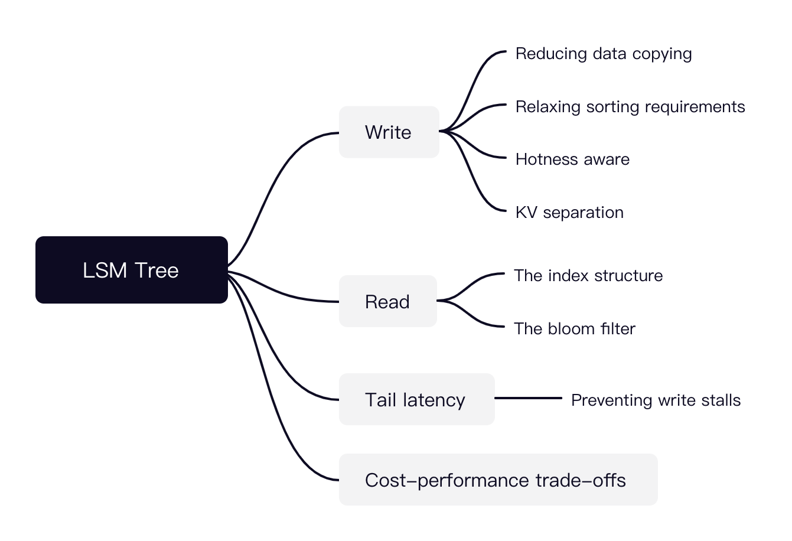
LSM Tree is a hot research topic today
Many possible directions

Slide 62
Consistency model

Slide 63


Motivating application: Chat APP
Abstracted data type
Chat: a chat to someone (or a group)
Sentence: the detailed sentence from a conversion
Operation: add a sentence to a chat
Typical system to support the APP: key-value storage
E.g., each sentence can be uniquely identified by <sid, "some sentence”>
Each chat can be uniquely identified by <cid, [a list of sids]>
Chat APP
Chat (cid=0)
Chat (cid=1)
...
Sentence
(pid=2)
Photo
(pid=1)
Sentence
(Sid=0)
Sentence (pid=0)
Sentence (sid=0)

Slide 64
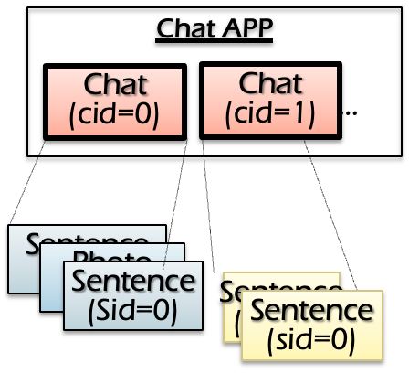

How is the key-value storage (KVS) deployed?
Approach #1: store the KVS at a centralized server
The server resides in a datacenter (e.g., 贵州)
The server can be made highly reliable (see later lectures)
e.g., on the user’s perspective, “never crashes”
All operations: execute an RPC at the server
What are the drawbacks?
Inefficiency! Must wait for server ACKs
Cannot work with offline!
Server
Network
X
Y
Client
Add sentence X
Read sentence Y
Client
Notes:
Can tolerate more failures than a phoen

Slide 65
How is the key-value storage (KVS) deployed?
Approach #2: store the KVS at a centralized server + at each device
Default implementation of many ChatAPP, e.g., WeChat ☺
Question: how to do the updates? We need to sync with other devices!
Naïve solution
Read: return the latest copy on the local KVS
Write: update the local KVS, sync with other KVS, then return to client
Client
Client
Server
Notes:
Can tolerate more failures than a phoen

Slide 66
Naïve solution: what does the sync mean?
Read: return the latest copy on the local KVS
Write: update the local KVS, sync with other KVS, then return to client
Time
Hello world
KVS write
Start
Hello world
Done
Hello world
Server
Notes:
Timeline
TBD: 动画

Slide 67
Naïve solution: wait sync for each updates
Problem#1: inefficiency (read is good, but not for write)
Each write must wait for the sync to be done, which may be lengthy
Numbers every programmer is suggested to know
RTT among devices: 100 – 400ms
Start
Done
Server

Slide 68
Naïve solution: wait sync for each updates
Problem#2: cannot tolerate network connectivity
Periodic connectivity to net and other nodes (e.g., lost WIFI)
Common under the setup of chat APP (e.g., I have entered the subway ☺)
Under network disconnection, the sender will be blocked
Start
Server

Slide 69
Naïve solution++: sync but not wait
Read: return the latest copy on the local KVS
Write: update the local KVS, sync with the others in background & return
Time
Hello world
KVS write
Start
Done
Server

Slide 70
Question: what can go wrong?
Naïve solution++: sync but not wait
An obvious problem is that we may not get the latest messages (a common case in WeChat ☺)
But there is more subtle consistency issue
What does inconsistency mean?
Intuitively, the same thing is not the same from different perspectives
The thing can be the data itself (e.g., missing an update)
The thing can be how the data is read/write (order mismatches)

Slide 71
Question: what can go wrong?
Considering the following scenario:
Me -> Boss: boss, I want to quit
Boss -> HR: Yubin (me) wants to quit
Boss -> Me: OK
Me -> HR: Boss has confirmed that I can quit (link to msg 2).
The HR’s job:
If sees “Boss has confirmed that I can quit” from Yubin, check whether “Yubin wants to quit” has been sent by the boss

Slide 72



Question: what can go wrong?
I want to quit
Me
Boss has confirmed that I can quit (link to msg 2).
Yubin wants quit
Boss
Ok
Message lost
HR

Slide 73
Question: what can go wrong? (Abstracted version)
Example scenario
Me -> Boss: boss, I want to quit
Boss -> HR: Yubin wants to quit (x)
Boss -> Me: OK
Me -> HR: Boss has confirmed that I can quit (link to msg x). (y)
The HR’s job:
If sees “Boss has confirmed that I can quit. ” (y’s update), check whether “Yubin wants to quit” has been sent (x must have been updated)

Slide 74
Question: what can go wrong? (Abstracted version)
We have two data, X and Y (initialized as 0)
Process #1: Put (X,1), Put (Y,1)
Process #2: If sees Y = 1, Print (X) // must be 1
Unexpected behavior
Process #2 sees Y = 1, But not X = 1
Notes:
C0: PUT("x",1);
PUT("y",1);
C1:
while ((y = GET("y"))!=1);
x = GET("x");
print x, y
Intuitive intent: C1 should print x=1, y=1

Slide 75
Question: what can go wrong? (Abstracted version)
Unexpected behavior
Process sees Y = 1, But not X = 1
Questions
Can the unexpected behavior happen in approach #1 (a single centralized KVS and RPC for all the operation implementation)?
Notes:
C0: PUT("x",1);
PUT("y",1);
C1:
while ((y = GET("y"))!=1);
x = GET("x");
print x, y
Intuitive intent: C1 should print x=1, y=1
Depends on the implementation

Slide 76
Question: what can go wrong? (Abstracted version)
Unexpected behavior
Process sees Y = 1, But not X = 1
Questions
Can the unexpected behavior happen in approach #1 (a single centralized KVS)? No.
Can the unexpected behavior happen in approach #2’s naïve (sync for each update)? No.
Notes:
C0: PUT("x",1);
PUT("y",1);
C1:
while ((y = GET("y"))!=1);
x = GET("x");
print x, y
Intuitive intent: C1 should print x=1, y=1

Slide 77
Naïve++ is efficient, but have unexpected behavior
A trade-off. The unexpected behavior is usually called inconsistency
How can we write correct distributed programs?
The developer must cope with inconsistency issues!
How to cope with inconsistency?
The system must provide a consistency model when operating the distributed data, which defines what can happen (not always) and not cannot happen

Slide 78
Consistency model
How a data storage system behavior under concurrency, distribution and failure
E.g., in GFS, the consistency model is that all the chunk will eventually be the same
A strong consistency model will give more precise on what can happen & what cannot
E.g., no reorder of events
A weak one typically has few hints (so it is weak ☺)

Slide 79
Consistency Challenges
No Right or Wrong consistency models
Tradeoffs between ease of programmability & performance
Why programmability?
Unexpected behavior usually needs to be fixed by the developers ☺

Slide 80
Spectrum of Consistency Models
Focus of this our course
Better performance/
Fault tolerance
Sequential
Strict
Eventual
Release
Linearizability
Easy to use
Note that many other models exists

Slide 81
What is the desired model for the developers/users?
i.e., what makes a strong consistent model for distributed systems?
It's easy for users to reason about correctness assuming
Everything has only one-copy
The overall behavior is equivalent to some serial behavior
The overall behavior can be viewed as a system that never fails (see later lectures)

Slide 82
Example: equivalence to some serial execution
Though being concurrent, we can map it to some serial order
E.g., one device, execute the chat one by one (as an atomic unit)
Put(X,1)
Done
Put(Y,1)
Done
P0
Get(Y)
1
Get(X)
1
P1
Put(X,1)
Done
Done
Put(Y,1)
Get(Y)
1
Get(X)
1
Notes:
C0: WR(x=1) WR_ok(x) WR(y=1) WR_ok(y) C1: RD(y=?) RD_ok(y=1) RD(x=?) RD(x=1)
An equivalent sequential history
C0: C1:
C0: C1:
WR(x=1) WR_ok(x) WR(y=1) WR_ok(y)
WR(x=1)
WR_ok(x) RD(y=?) RD_ok(y=1)
RD(y=?) RD_ok(y=1) RD(x=?) RD(x=1) WR(y=1) WR_ok(y) RD(x=?) RD(x=0)
An "equivalent" sequential history C0: WR(x=1) WR_ok(x) WR(y=1) WR_ok(y) C1: RD(x=?)RD_ok(x=0)

Slide 83
Can this concurrent exe. equivalent to some serial exe.?
Note all concurrent execution (exe.) can be deduced to a serial execution
Put(X,1)
Done
Put(Y,1)
Done
P0
Get(Y)
0
Get(X)
0
P1
Get(Y)
0
Put(X,1)
Done
Put(Y,1)
Done
Get(X)
0
Notes:
Less intuitive, but still correct

Slide 84
Can this concurrent exe. equivalent to some serial exe.?
Note all concurrent execution (exe.) can be deduced to a serial execution
Put(X,1)
Done
Put(Y,1)
Done
P0
Get(Y)
1
Get(X)
0
P1
Can you derive an equivalent serial order?
Notes:
Less intuitive, but still correct

Slide 85
Proof: we cannot find an equivalent serial execution
Case #1.
Get(Y)
0
Put(X,1)
Done
Put(Y,1)
Done
Get(X)
0
Case #2.
Put(X,1)
Done
Done
Put(Y,1)
Get(Y)
1
Get(X)
1

Slide 86
Proof: we cannot find an equivalent serial execution
Case #3.
Get(Y)
0
Put(X,1)
Done
Put(Y,1)
Done
Get(X)
1
Case #4.
Get(Y)
0
Put(X,1)
Done
Put(Y,1)
Done
Get(X)
1
Notes:
Case study： HR 没看到我发的 消息，所以不会去看X

Slide 87
Proof: we cannot find an equivalent serial execution
Case #5.
Put(X,1)
Done
Get(Y)
0
Put(Y,1)
Done
Get(X)
1
Case #6.
Put(X,1)
Done
Get(Y)
0
Put(Y,1)
Done
Get(X)
1
Notes:
Case study： HR 没看到我发的 消息，所以不会去看X

Slide 88
Key problem: order mismatches
Put(X,1)
Done
Put(Y,1)
Done
P0
Get(Y)
1
Get(X)
0
P1
Update order observed by P0:
X first, then Y
Update order observed by P1:
Y first, then X
In a serial order, only one can happen

Slide 89
Recall: What is the right model?
It's easy for users to reason about correctness assuming
Everything has only one-copy
The overall behavior is equivalent to some serial behavior
Typically, a convenient consistency model is defined by
Every data has only “one copy” (logically)
The concurrent read/write behavior is equivalent to some serial order
Question: which serial order to give?
So many (possible) serial behaviors

Slide 90
How to define the equivalent serial order?
#1. Global issuing order (strict consistency)
#2. Per-process issuing/completion order (sequential consistency)
#3. Global "completion-to-issuing" order (linearizability)

Slide 91
Try #1. Use strict consistency
Strict consistency: global issuing order
All the concurrent execution is equivalent to a serial execution
The order of each op matches the global wall clock time
Example
Put(X,1)
Done
Put(Y,1)
Done
P0
Issue time
Get(Y)
1
Get(X)
1
P1
Put(X,1)
Done
Done
Put(Y,1)
Get(Y)
1
Get(X)
1

Slide 92
Try #1. Use strict consistency
Is the following serial order matches global issuing time?
No. Put (X,1) must be executed first.
Put(X,1)
Done
Put(Y,1)
Done
P0
Get(Y)
0
Get(X)
0
P1
Get(Y)
0
Put(X,1)
Done
Put(Y,1)
Done
Get(X)
0

Slide 93
Try #1. Use strict consistency
Is the following serial order matches global issuing time?
No. Put(Y) must be executed before the Get(Y)
Put(X,1)
Done
Put(Y,1)
Done
P0
Issue time
Get(Y)
0
Get(X)
1
P1
Put(X,1)
Done
Put(Y,1)
Done
Get(Y)
0
Get(X)
1

Slide 94
Strict consistency: Pros & Cons
Pros
The strongest consistency model for single value operations
Fallback to a single thread, executing each operations one by one
Cons
Impractical to implement in a distributed setup
For performance & correctness reasons (i.e., no global wall time)

Slide 95
Implementing strict consistency: challenge
Assuming we implement strict consistency using a centralized KVS
The simplest setup we can get in a distributed setting
Question: how the KVS can determine to process Put(Y,1) or not?
Put(X,1)
P0
Put(Y,1)
P1

Slide 96
How to define the equivalent serial order?
#1. Global issuing order (strict consistency)
#2. Per-process issuing/completion order (sequential consistency)
#3. Global "completion-to-issuing" order (linearizability)
Also convenient, but are practical to implement

Slide 97
Try #2. Use sequential consistency
#2. Per-process issuing/completion order (sequential consistency)
All the concurrent execution is equivalent to a serial execution
The order of each op matches per-process issuing/completion order
Put(X,1)
Done
Put(Y,1)
Done
P0
Get(Y)
0
Get(X)
0
P1
Allowed
Get(Y)
0
Put(X,1)
Done
Put(Y,1)
Done
Get(X)
0

Slide 98
Problem of sequential consistency
Key problem: missing updates
Put(X,1)’s finish is before the start of Get(X)
But the later Get(X) cannot observe the latest update!
Put(X,1)
Done
Put(Y,1)
Done
P0
Get(Y)
0
Get(X)
0
P1
Allowed
Get(Y)
0
Put(X,1)
Done
Put(Y,1)
Done

Slide 99
Try #3. Use linearizability
#3. Linearizability "completion-to-issuing" order
All the concurrent execution is equivalent to a serial execution
The order of each op matches "completion-to-issuing"
Put(X,1)
Done
Put(Y,1)
Done
P0
Done time
Get(Y)
0
Get(X)
0
P1
Issue time
Allowed
Get(Y)
0
Put(X,1)
Done
Put(Y,1)
Done
Get(X)
0
Notes:
Read the most recent writes

Slide 100
2 or 3, which to choose?
In practice, 3 is in favor of 2
E.g., P0 finishes X. But later P1 cannot sees its effect!
Put(X,1)
Done
Put(Y,1)
Done
P0
Get(Y)
0
Get(X)
0
P1
Allowed
Get(Y)
0
Put(X,1)
Done
Put(Y,1)
Done
Get(X)
0

Slide 101
Implementing linearizability of KVS

Slide 102
Warmup property of linearizability: The local property ^{[1]}
If each object’s op is linearizable, then overall system is linearizable
(Very) Simplified & (very) informal proof (By contradiction)
Suppose we have two ops on x,y, e1 & e2
If non-linearizable, then we must have e1 < e2 & e2 < e1
This is impossible:
real_time(e1_ok) < real_time(e2_start) // e1 < e2
real_time(e2_start) < real_time(e2_ok) // execution have time
real_time(e2_ok) < real_time(e1_start) // e2 < e1
real_time(e1_ok) < real_time(1_start) // combine the upper formulars
Since real_time(e1_start) < real_time(e1_ok), contradiction happens
The concrete proof needs to reason on multiple ops & objects (w/ graph)
[1] Linearizability: A Correctness Condition for Concurrent Objects， TPLS’90

Slide 103
Why locality is important to implement linearzability? We only need to ensure operations on a single object is linearizable!

Slide 104
The simplest approach: centralized KVS
Basic model
There is only one centralized KVS in the system
Put: Send an RPC to the KVS, wait for it to be done
Get: Send an RPC to the KVS to read the result
Put(X,1)
Put(X,1)
P0
It is incorrect to view the put as done if the ack is not received
P1
Get(X)
Notes:
Why not this approach?

Slide 105
Approaches for replicated KVS: replicated KVS
Model (More suitable for the chat app)
Each device has a replicated KVS on its local machine
Question: how can the Get/Put being implemented?
P0
P1

Slide 106
Approaches for replicated KVS (more realistic)
Put
How many servers need the client send the updates to?
Must a client wait till all servers sent have processed the update?
Read
Which server will the read sent to?
Can a server always return its current value?
P0
P1

Slide 107
Approach #1. Primary-backup model
For each object, Clients send all reads/writes at a designated machine
For writes
Primary forwards writes to all the replicas
M0 executes writes locally (in order)
Respond OK
Primary
Write(x,1)
Write locally
Done
P0
forward
forward
P1

Slide 108
What does the 「in order」 mean?
Suppose we have two writes send to the primary
Due to network problem, the message may reorder
If the reorder happens, it is possible that two replicas apply the same writes in a different order!
Primary
Write(x,1)
Write(x,2)
P0
1
2
forward
P1
2
1

Slide 109
In order updates: Primary must use some seq number
Seq number: orders of update
Possible implementation: a global counter
Incremented upon receive a write request
All replica apply writes in the order of seq number
Delay writes if the previous write has not been finished
Primary
Write(x,1)
Write(x,2)
P0
1
2
1
2
Forward <2, 1>
Forward <1, 1>
P1
0
1
2

Slide 110
Question: where to implement the in-order semantic?
At the network layer
May rely on the transport (e.g., RPC or TCP/IP) layer to implement
But we can also implement it at the application layer
E.g., the primary stores a global counter
Not so hard, and is more flexible
Primary
Write(x,1)
Write(x,2)
P0
1
2
1
2
Forward <2, 1>
Forward <1, 1>
P1
0
1
2

Slide 111
Approach #1. Primary-backup model
For writes
Primary forwards writes to all the replicas
M0 executes writes locally (in order)
Respond OK
Read: return the local copy of the data of the primary
Primary
Write(x,1)
Write locally
Done
P0
Read(x)
1
forward
forward
P1

Slide 112
Drawback of the primary-backup model
Performance issues of reads and writes
Read: extra RTT for contacting the primary
Writes: extra RTTs for contacting the primary + backups
Scalability issue: the primary may become the bottleneck!
Reliability issue: what if some primary of backups crash? (Not today)
Primary
Write(x,1)
Write locally
Done
P0
Read(x)
1
forward
forward
P1

Slide 113
Why read from arbitrary replica can cause issues?
For writes
Primary forwards writes to all the replicas
M0 executes writes locally (in order)
Respond OK
Read: return the local copy of the data on any replica
Primary
Write(x,1)
Write locally
Done
P0
Read(x)
1
forward
forward
P1

Slide 114
Question: Is approach #2 linearizable?
Read-2 < Read-1
Write < Read-1
Read-1 < Read-2 (Read-1’s completion is before Read-2)
Primary
Write(x,1)
Read-2(x)
0
Ok
P0
Read-1(x)
1
forward
P1

Slide 115
Summary
It is challenging to distributed object distributed
Consistency issue
It is also challenging to define the consistency model
Different trade-offs
Correct consistency model is defined via serial execution
Strict
Sequential
Linearizable
Implementation trades performance (and reliability) for correctness

